Slide 1
Unit 2. The phases of a Compiler

Slide 2
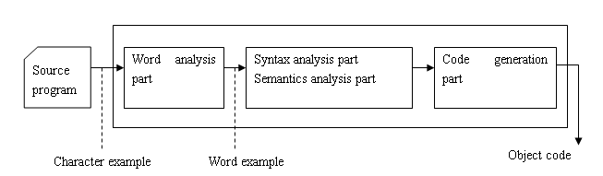
Main phases of a compiler

Slide 3
Phases of a compiler
Lexical Analysis
Stream of characters making up the source program is read from left to right and grouped into tokens (sequences of characters having a collective meaning)
Syntax Analysis
Group the tokens of the source program into grammatical phrases that are used by the compiler to synthesize output

Slide 4
phases of a compiler
Semantic Analysis: Check the source program for semantic errors and gather type information for the subsequent code generation part.
Intermediate Code Generation: Generate an intermediate representation as a program for an abstract machine.

Slide 5
phases of a compiler
Code optimization : Improve the intermediate code so that faster running code will result
Code generation: Generation of target code, consisting normally of relocatable machine code or assembly code

Slide 6
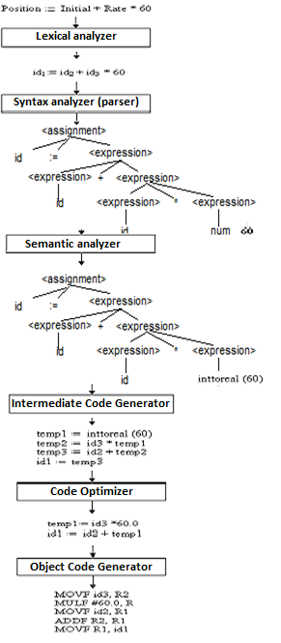
Translation of a statement

Slide 7
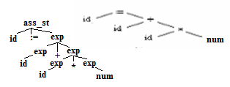



Details of the phases of a Compiler
phase | Output | Sample
Programmer (source code producer) | Source string | Position:= inition * rate + 60
Scanner (performs lexical analyzer) | Token string | position’, ‘:=’, ‘inition’, ‘+’, ‘60’, And symbol table with identifier
Parser (performs syntax analysis based on the grammar of the programming language) | Parse tree or abstract syntax tree
Semantic analyzer (type checking, etc) | Annotated parse tree or abstract syntax tree | Convert integer (60) to real
Intermediate code generator | Three-address code
Optimizer | Three-address code
Code generator | Assembly code
Notes:
Parse tree show the concrete syntax (how tokens are grouped together)
the tree initially constructed by the parser
Abstract tree show the semantically significant structure
the tree returned by the parser and manipulated by type checker
The structure of trees
Parse tree:
nodes: nonterminals (= syntactic categories)
leaves: terminals (= tokens)
Abstract tree:
nodes: constructor functions
leaves: atoms (= zero-place constructor functions)
The definition and construction of trees
Parse trees are defined by context-free grammars
Exp ::= Exp "+" Exp ; Exp ::= "2" ; Exp ::= "3" ;
Abstract trees are defined by constructor type signatures
plus : (Exp, Exp) -> Exp 2 : Exp 3 : Exp
From concrete to abstract syntax
1. Give a name (= label) to each rule:
Exp ::= Exp "+" Exp ==> plus. Exp ::= Exp "+" Exp
2. Ignore terminals (= tokens, in quotes):
plus .Exp ::= Exp "+" Exp ==> plus. Exp ::= Exp Exp
3. Treat label as constructor name, LHS (left-hand-side) as value type, RHS as argument types:
plus. Exp ::= Exp Exp ==> plus : (Exp, Exp) -> Exp

Slide 8
The Grouping of phases
Compiler front and back ends:
Front end: analysis (machine independent)
Back end: synthesis (machine dependent)
Compiler passes:
A collection of parts is done only once (single pass) or multiple times (multi pass)
Single pass: usually requires everything to be defined before being used in source program
Multi pass: compiler may have to keep entire program representation in memory

Slide 9
Phase 1:Lexical Analysis
Scanner: Converts the stream of input characters into a stream of tokens that becomes the input to the following phase (parsing)
Tasks of a scanner
Group characters into tokens
Token: the syntax unit
Categorization of tokens.
Token types: Identifier, Number, Character constant, operators…..

Slide 10
Phase 2: Parsing
The process of determining if a string of token can be generated by a grammar
Is executed by a parser

Slide 11
phase 2: Parsing
Output of a parser:
Parse tree (if any)
Error Message (otherwise)
If a parse tree is built succesfully, the program is grammatically correct

Slide 12
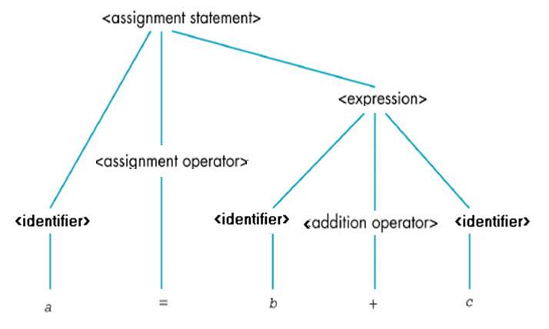
Parse tree of statement a = b + c

Slide 13
Grammars,languages, BNF,syntax diagrams
The parser takes the token produced by scanner as input and generates a parse tree (or syntax tree). Token arrangements are checked against the grammar of the source language.
Notations for grammar:
BNF (Backus-Naur Form) is is a meta language used to express grammars of programming languages
Syntax Diagrams : A pictorial diagram showing the rules for forming an instruction in a programming language, and how the components of the statement are related. Syntax diagrams are like directed graphs.

Slide 14
BNF
BNF (and formal grammars) use 2 types of symbol
Terminals :
Tokens of the language
Never appear in the left side of any production
Nonterminals
Intermediate symbol to express structures of a language
Must be in a left side of at lease one production
Enclose in <>
Start symbol
Nonterminal of the first level
Appear at the root of parse tree

Slide 15
Grammars,languages, BNF,syntax diagrams
Start symbol :
Nonterminal of the first level
Appear at the root of parse tree

Slide 16
Parsing: Concept and Techniques
Continuously apply grammatical rules until a string of terminal is generated.
If the parser convert first symbol into the input string, it is syntactically correct
Otherwise, string is not syntactically correct

Slide 17
Parsing: Concept and techniques
The most important thing of a compiler: grammar
Grammar includes all structures of a program
Not includes any other rule

Slide 18
Parsing: Concept and Techniques
Grammar must be unambiguous
If grammar is ambiguous, more than one parse tree can be created

Slide 19
Phase 3: Semantic Analysis
Certain check are performed to ensure that the components of a program fit together meaningfully
To generate code, source program must be syntactically and semantically correct

Slide 20
Phase 4: Intermediate code generation
Source program is transferred to an equivalent program in intermediate code by intermediate code generator
Intermediate code is close to the target code, which makes it suitable for register and memory allocation, instruction set selection, etc.
It is good for machine-dependent optimizations.

Slide 21
Advantages of Intermediate Code
Easy to translate into object code.
Code optimizer can be applied before code generation
Decrease time cost

Slide 22
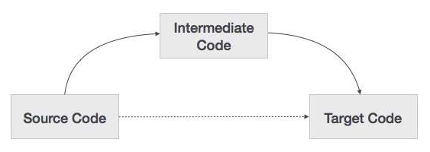
Phase 5: Code Generator
Input: Intermediate code of source program
Output: Object program
Assembly code
Virtual machine code

Slide 23
Problems
Input
Output
Object machine
Set of instruction
Register allocation

